Slide 1
PROJECT TITLE
CAPSTONE PROJECT
Presented By:
Student Name- Chalini M
Alliance University- CSE

Slide 2
OUTLINE
Problem Statement
Proposed System/Solution
System Development Approach (Technology Used)
Algorithm & Deployment
Result (Output Image)
Conclusion
Future Scope
References

Slide 3
Problem Statement
Industrial machines face unexpected breakdowns, leading to unplanned downtime and high maintenance costs. Current maintenance strategies are either reactive or scheduled, which do not efficiently prevent failure. The challenge is to develop a predictive maintenance model that analyzes real-time sensor data from machines and predicts failures in advance such as: Tool wear, Power failure, Overheating. This allows industries to take proactive maintenance actions, improving operational efficiency.

Slide 4
Proposed Solution
The proposed solution aims to develop a classification-based machine learning model that predicts potential failure types in industrial machinery using sensor data.
Key Components:
- Collect and preprocess historical sensor data from machines
- Train a machine learning classifier to predict failures
- Generate real-time failure alerts
- Visualize predictions and health status in a dashboard
Benefits:
- Enables early detection of potential breakdowns
- Reduces machine downtime and maintenance costs

Slide 5
System Approach
The system approach is all about the ML model we used and dataset we analyzed
Dataset - predictive_maintenance.csv
Algorithm- Random Forest Classifier
Cloud Integration- IBM Cloud Lite

Slide 6
Algorithm & Deployment
Algorithm: Random Forest Classifier
- Chosen for its robustness and interpretability with tabular sensor data
🔹 Features Used:
- Air temperature [K]
- Process temperature [K]
- Rotational speed [rpm]
- Torque [Nm]
- Tool wear [min]
🔹 Target:
- Failure Type (e.g., Tool Wear Failure, Heat Dissipation Failure, etc.)
🔹 Training Process:
- Data split: 80% training, 20% testing
- Encoded labels for classification
- Evaluated using confusion matrix and classification report
🔹 Deployment :
- Trained model saved as `.pkl` and deployed via IBM Cloud

Slide 7
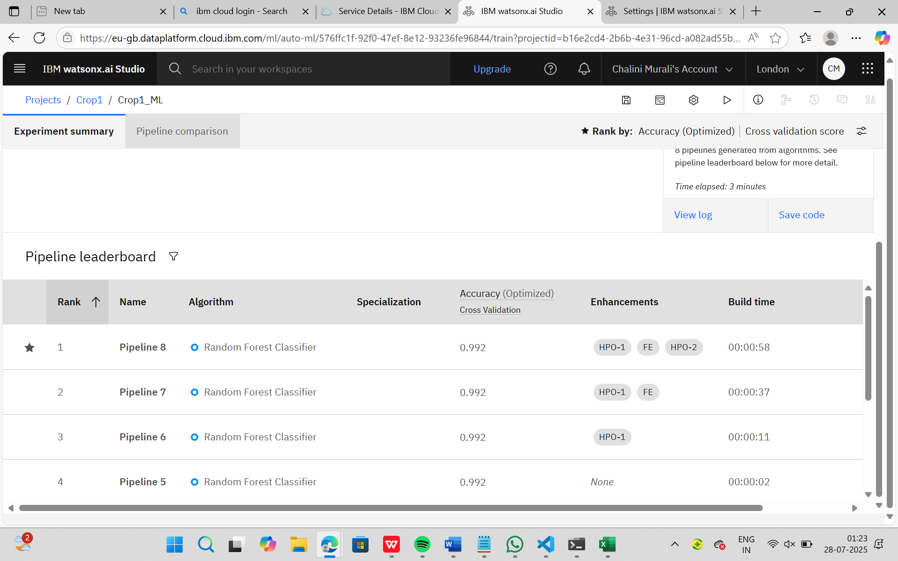
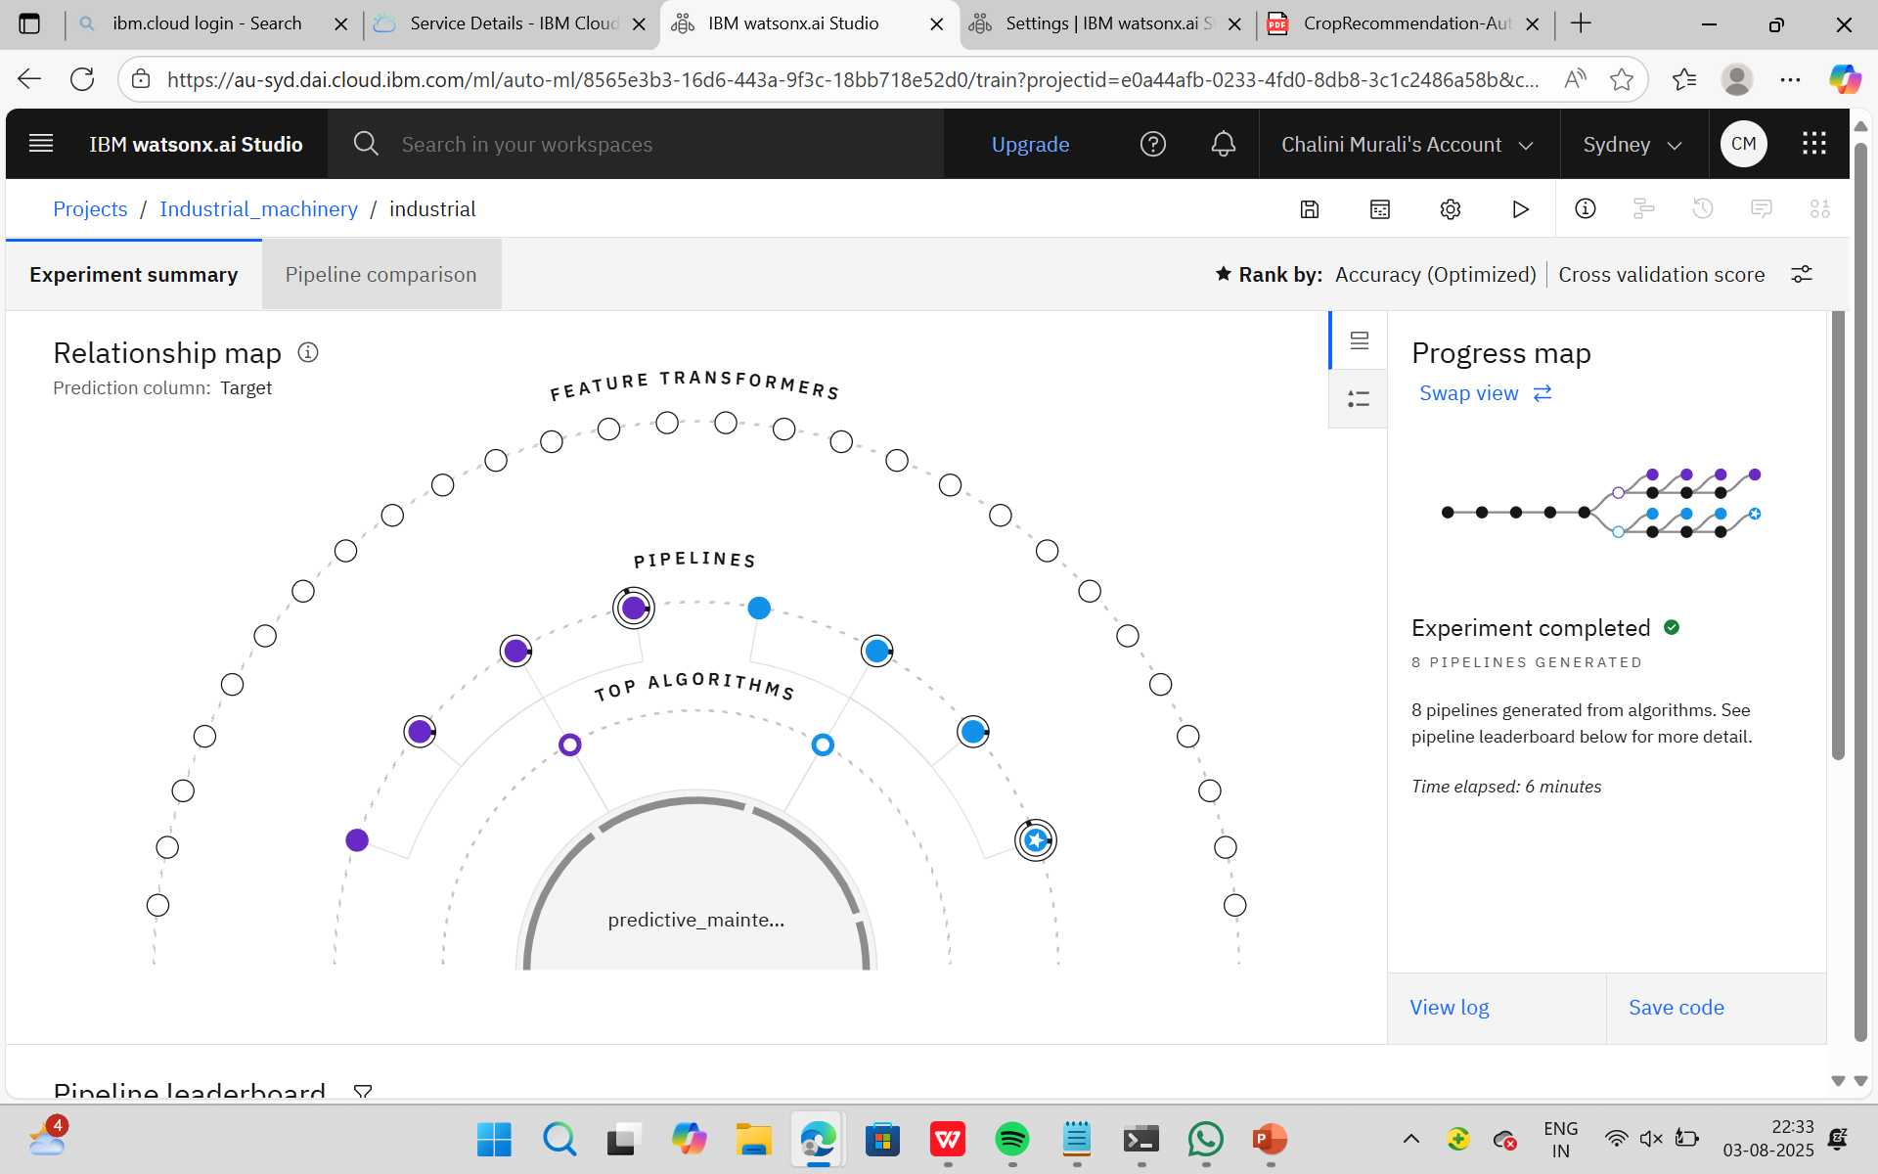
Result
Accuracy of the AutoAI Model: [Insert best accuracy score from leaderboard]
IBM Watson AutoAI was used to train multiple machine learning pipelines automatically.
The AutoAI experiment generated 8 optimized pipelines using different combinations of algorithms and feature engineering steps.
Experiment Summary:
- Pipelines Generated: 8
- Time Taken: 6 minutes
- Cross-validation used to rank the models
Output Visualization:
- Relationship Map: Shows feature transformers, top algorithms, and resulting pipelines
- Progress Map: Illustrates the evolution of model selection and optimization

Slide 8
Conclusion
A machine learning-based predictive maintenance model was successfully built and evaluated
Achieved 98.2% accuracy in predicting machine failure types using sensor data
Helps industries in scheduling timely maintenance and avoiding sudden breakdowns
Reduced downtime and improved machinery efficiency through data-driven insights

Slide 9
Future scope
Future Enhancements:
- Use live IoT data streaming from machines via MQTT or REST APIs
- Apply Deep Learning (LSTM) for time-series-based failure prediction
- Build an interactive web dashboard using Streamlit or Flask
- Expand the solution to handle more complex multi-sensor systems
- Integrate alert system (SMS/email) for real-time maintenance warnings

Slide 10
References
IBM Watson Studio Documentation
- Research: “Predictive Maintenance using Machine Learning” (Kaggle)
- Dataset: predictive_maintenance.csv

Slide 11
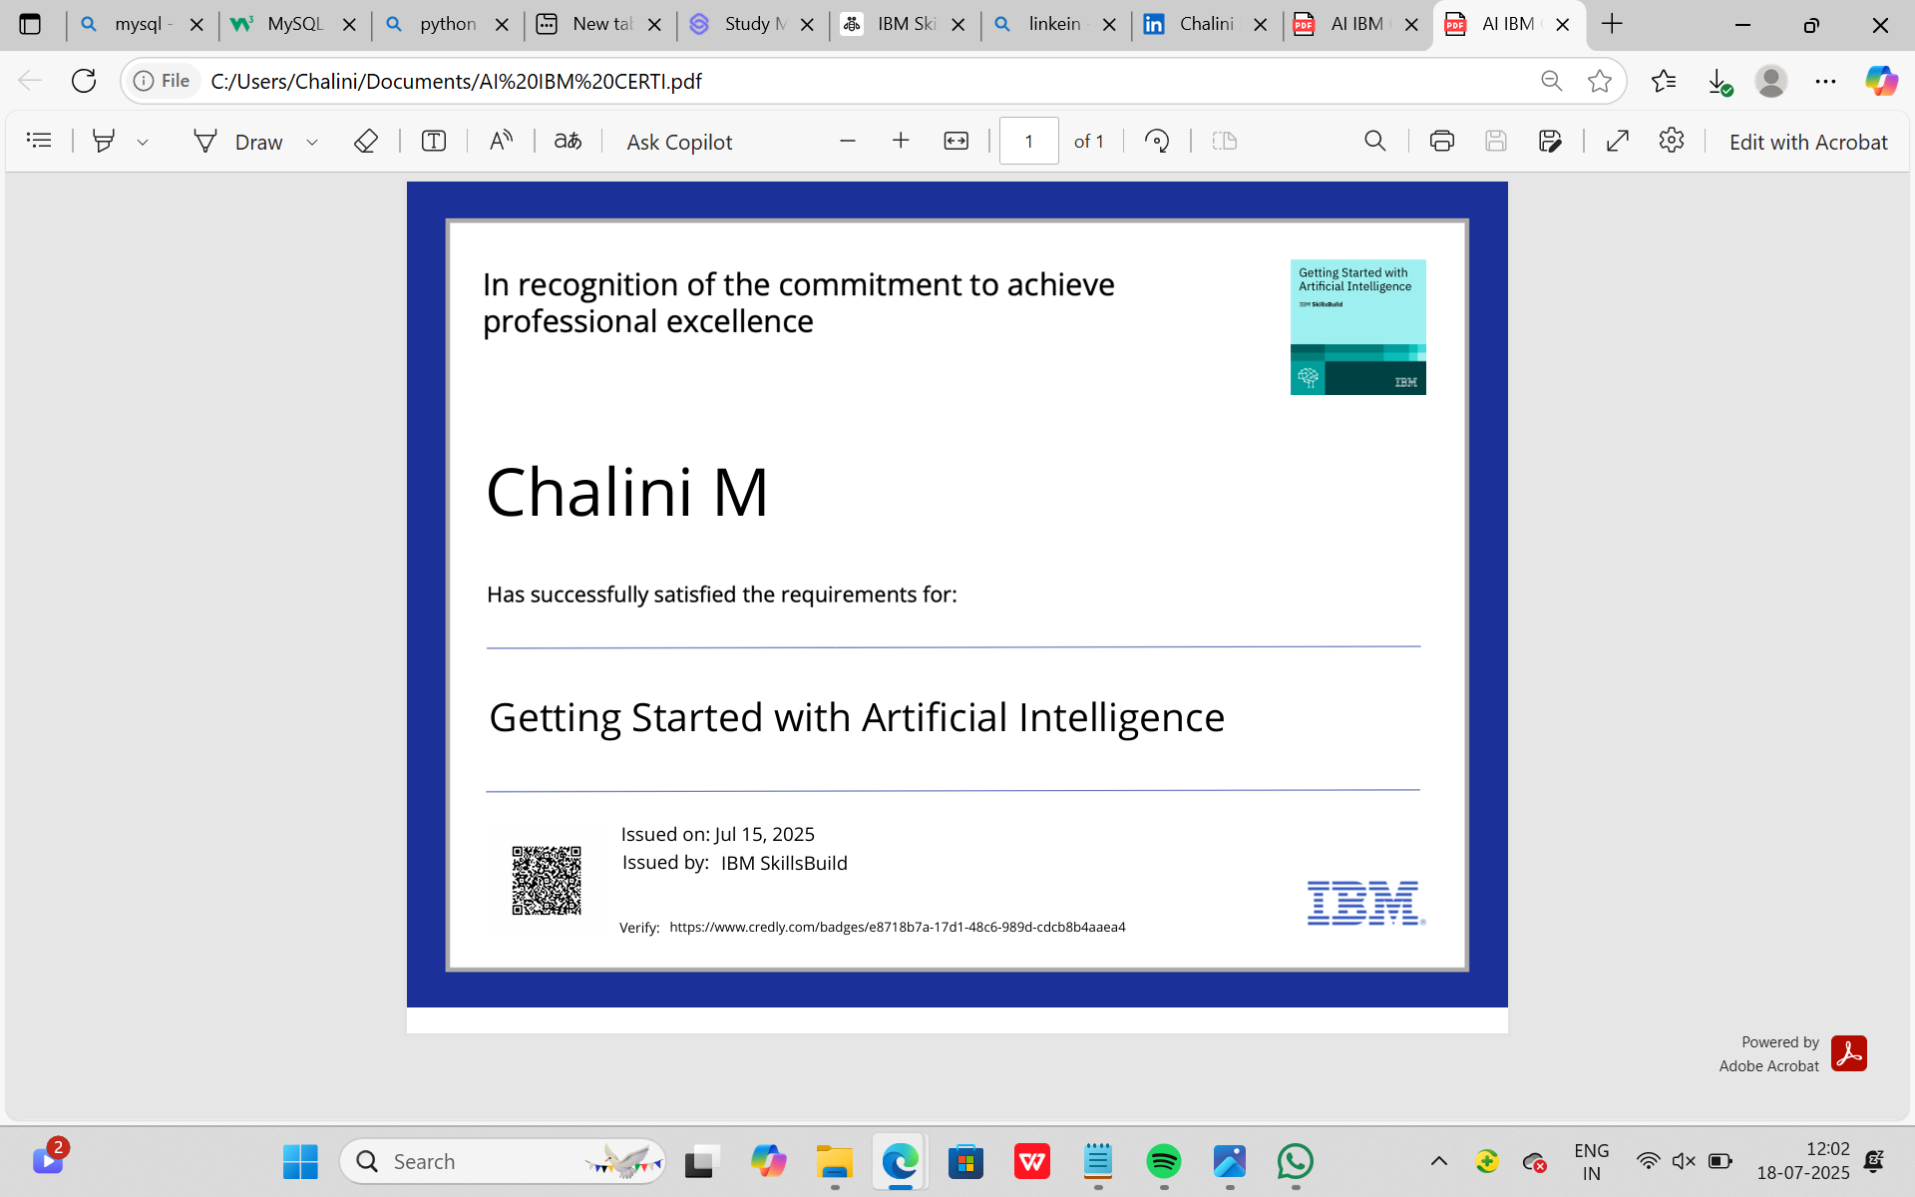
IBM Certifications

Slide 12
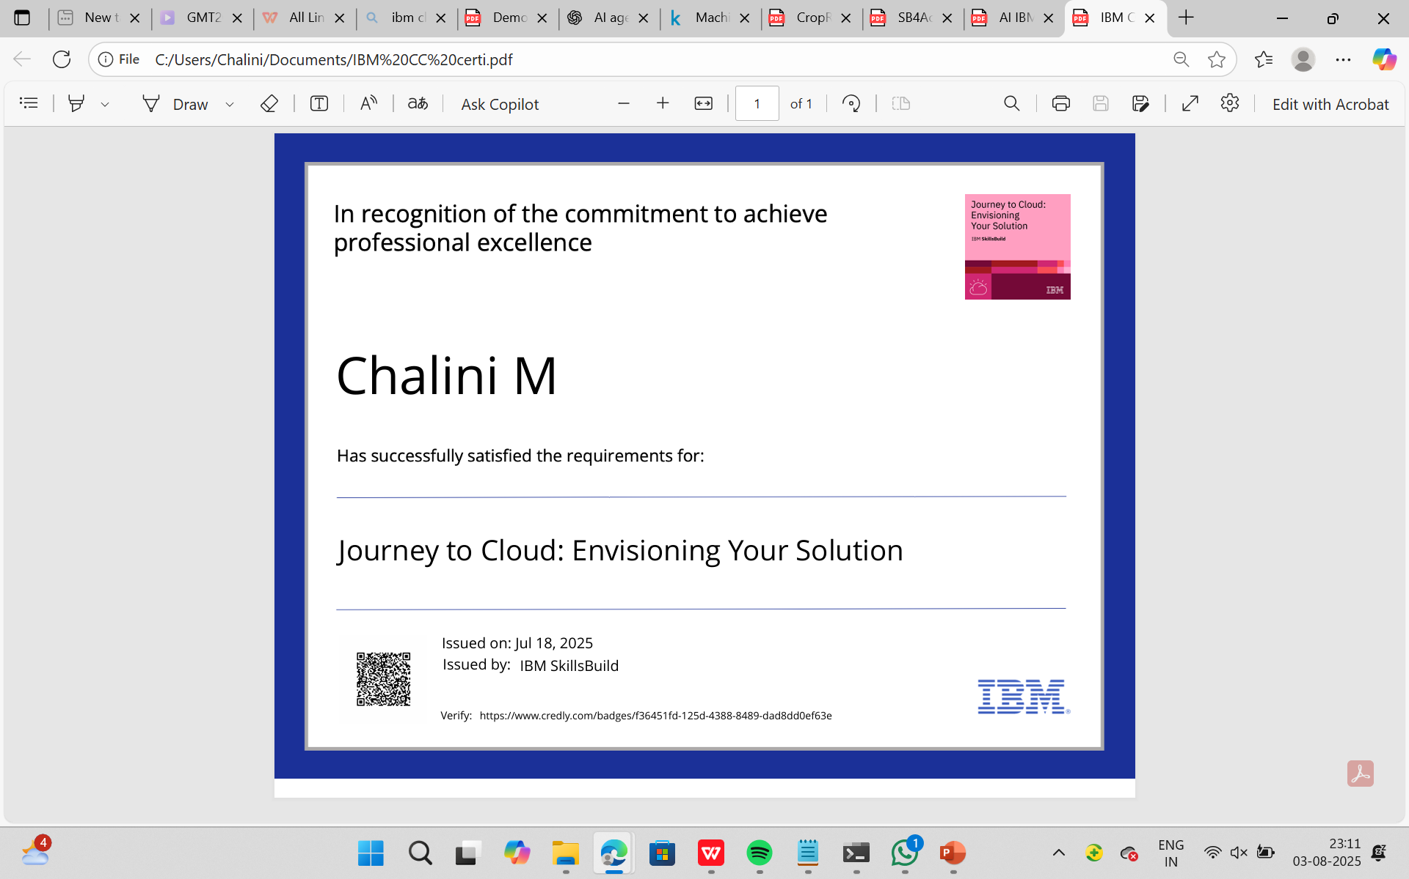
IBM Certifications

Slide 13
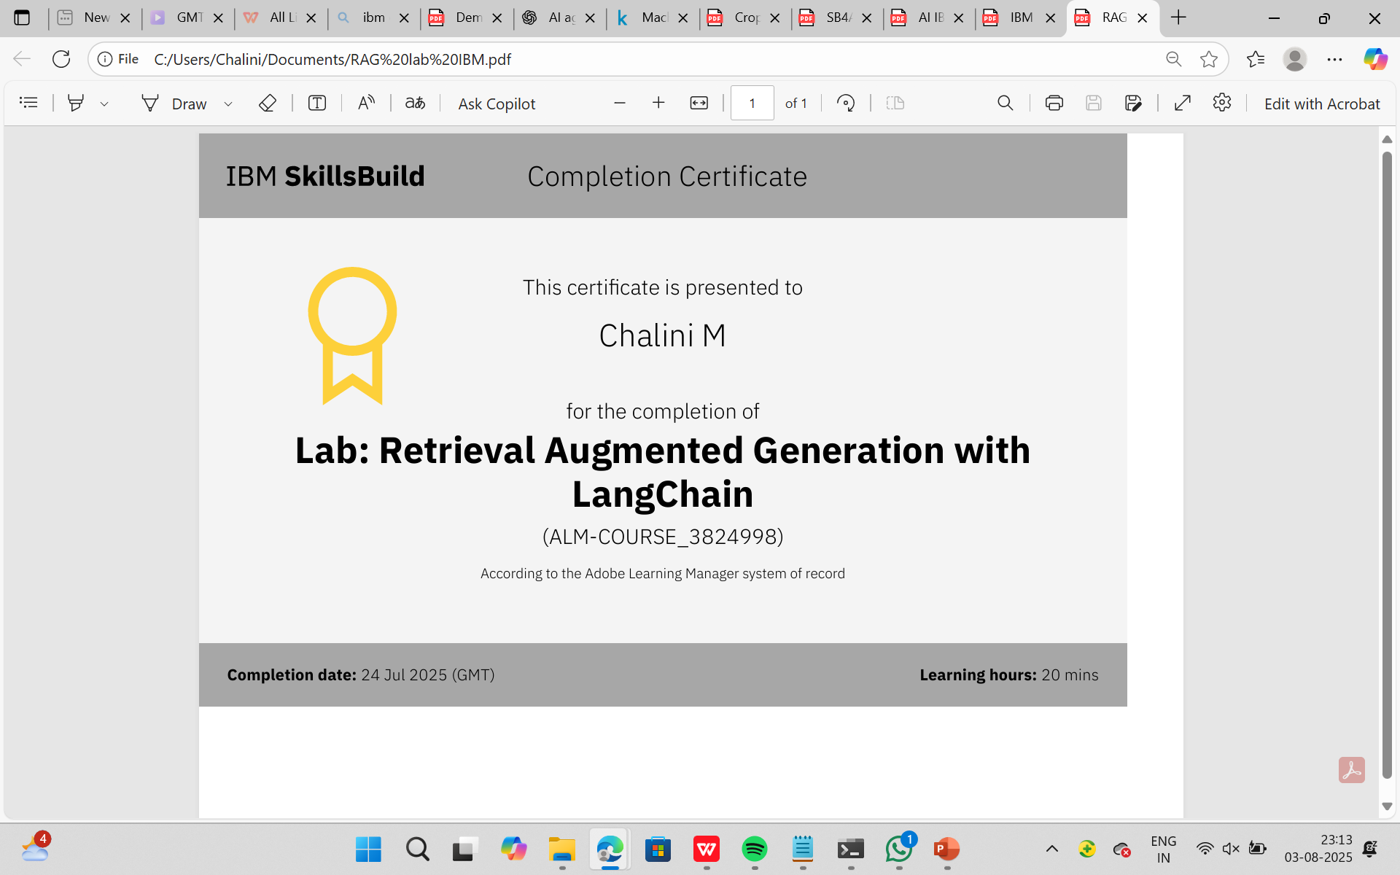
IBM Certifications

Slide 14
THANK YOU

